Slide 1
Simplified Data Access for Scientists
A presentation of the Qt language
Javad Chamanara
javad.chamanara@uni-jena.de

Slide 2


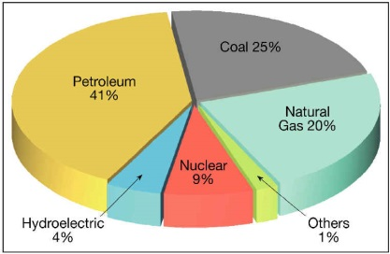
Data Scientists’ Digital Work
Scientist
Tools
Data
M | N | O | P
1 | 20 | A | 14
2 | 35 | B | 14
3 | 19 | C | 15
4 | 22 | A | 16
5 | 21 | D | 14
6 | 24 | D | 12
Result
Notes:
Data scientists use various tools to deal with data, which is usually coming from different sources.

Slide 3

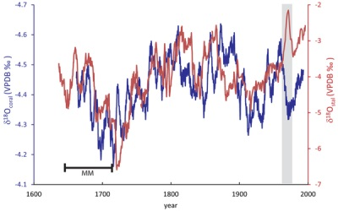
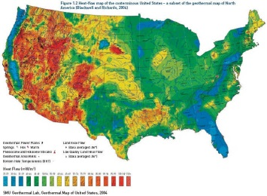

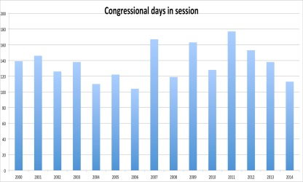
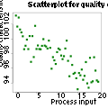
Data Scientists’ Using R
Data Frame
M | N | O | P
1 | 20 | A | 14
2 | 35 | B | 14
3 | 19 | C | 15
4 | 22 | A | 16
5 | 21 | D | 14
6 | 24 | D | 12
Notes:
When using R, the scientists would like to deal with data frames the most! They usually load the data from the sources into some data frames and start doing analyses!

Slide 4



But Data is Heterogeneous
CSV, TSV files
Spreadsheets
DBMSs
Notes:
Data are generated and stored in various formats.

Slide 5



Data Heterogeneity
Heterogeneity in:
Format
Data types
Units of measurement
Presentation/ model
And …
Notes:
Data are generated and stored in various formats.

Slide 6
Data Access Heterogeneity
Various DBMSs
Multitude of SQL variants
Multiple spreadsheet systems
Different programming languages
Notes:
To access various data source, there is a need to use various tools too.
Heterogeneity in data causes heterogeneity in access to the data

Slide 7
Effect on R users
Multiple systems working environment
Frequent import/export
Load bigger data into R
Harder data integration
Less reproducible work
More…
Notes:
Reduced share-ability
More dependency on IT specialists

Slide 8
Qt as the solution
Unified Language,
SQL like syntax
Query Execution System
Translates Qt to Data Source specific
Qt
XQt
CSV
Spreadsheet
DBMS
Data Sources

Slide 9
The query statement
CSV, spreadsheet, DB table
Previous Query results
Join of any combinations
Persistent Container
Source
Select
Target
Persistent Container
Source
Source
Memory variable
Memory variable
Joined Container
Plot
Native
Service
Operation
Aggregate
Filter
Transform
Order
Group
Limit
Notes:
Persistent container can be a CSV file, an Excel spreadsheet or a database table.
Results of previous queries can be held in memory and queries again.
Native source type allows to issue system specific queries and commands
Service Source type allows for calling remote services that return data

Slide 10
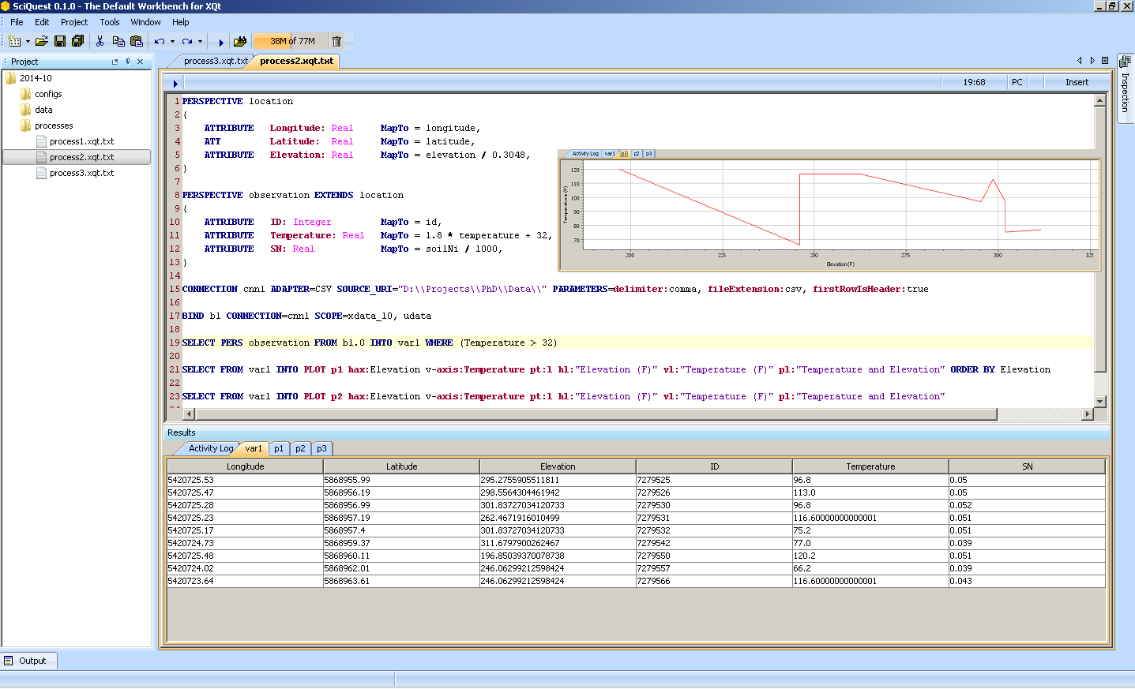
The workbench
Project explorer
Process/ Script editor
Result set viewer
Notes:
The workbench is the default query authoring and execution tool for Qt.

Slide 11
Examples
Some exemplary Qt queries using the workbench

Slide 12
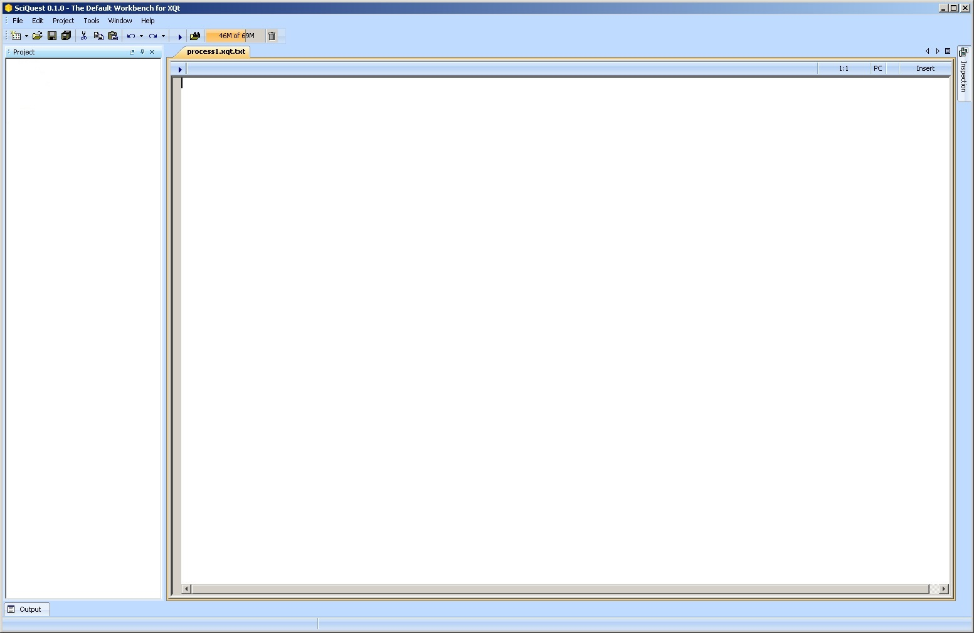
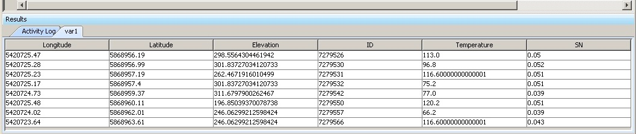
A basic Qt query
CONNECTION cnn1 ADAPTER=CSV SOURCE_URI="D:\Projects\MoSD\Data\"
BIND ds1 CONNECTION=cnn1 SCOPE=xdata_10 Version=Latest
SELECT FROM ds1.0 INTO var1
Formulates the query
Links the query to the connection
Specifies the data source
Notes:
Defines the information needed to connect to a data source.
Its possible to have more than one connections.
Each BIND can point to a connection.
SELECT statements grab source information from the bindings.

Slide 13
Using result sets of previous queries
CONNECTION …
BIND …
SELECT FROM ds1.0 INTO var1
SELECT FROM var1 INTO var2 ORDER BY temperature

Slide 14
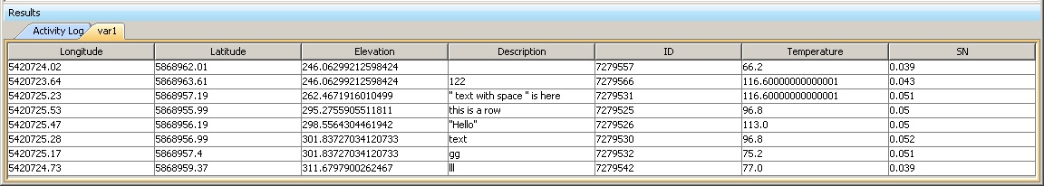
Filtering
SELECT FROM ds1.0 INTO var1
WHERE (Temperature > 50)
Any logical expression, including function calls

Slide 15
Ordering
SELECT FROM ds1.0 INTO var1
ORDER BY Elevation ASC
Ascending, Descending, Multiple attributes, Null filtering
Notes:
INTO: memory variable, plot, external container
Temperature is comming from the perspective, so its in Fahrenheit
Elevation is comming from the perspective, so its in foot

Slide 16
Offsetting
SELECT FROM ds1.0 INTO var1
LIMIT SKIP 1 TAKE 20
Puts the records into the result
Jumps over the records

Slide 17
Joining two files (containers)
CONNECTION …
BIND ds1 …
SELECT FROM ds1.data1 INNER JOIN ds1.data2 ON xk == yk INTO joined
INNER, LEFT and RIGHT OUTER JOIN
Comparison operators on the keys

Slide 18
Heterogeneous Join
CONNECTION cnn1 …
CONNECTION cnn1 …
BIND ds1 …
BIND ds2 …
SELECT FROM ds1.data1 INNER JOIN ds2.data2 ON xk == yk INTO joined
Left side data comes form source cnn1
Right side data comes from cnn2

Slide 19
What about schemas?
Schema determines the structure of the data
May contain data types
May contain constraints
Or metadata in general
But, where does it come from ?

Slide 20
From the files’ headers: CSV
TimePST,TemperatureC,Dew PointC,Humidity,Sea Level PressurehPa,VisibilityKm,Wind Direction,Wind SpeedKm/h,Gust SpeedKm/h,Precipitationmm,Events,Conditions,WindDirDegrees,DateUTC
12:56 AM,8.9,4.4,74,1022.2,16.1,Calm,Calm,-,N/A,,Partly Cloudy,0,2014-01-01 08:56:00
1:56 AM,6.7,2.2,73,1022.5,14.5,West,5.6,-,N/A,,Partly Cloudy,260,2014-01-01 09:56:00
2:56 AM,6.1,2.2,76,1022.5,16.1,Calm,Calm,-,N/A,,Partly Cloudy,0,2014-01-01 10:56:00

Slide 21
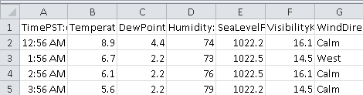
From the first row: Excel

Slide 22
From the system catalog: DBMS
rowindex integer,
year integer,
month integer,
day integer,
dep_time character varying(10),
dep_delay character varying(5),
arr_time character varying(10),
arr_delay character varying(5),
carrier character varying(10),
tailnum character varying(10),
flight character varying(10),
origin character varying(10),
dest character varying(10),
air_time character varying(10),
distance real,
hour character varying(5),
minute character varying(5)

Slide 23
From external headers: XQt
Attribute
Data Type
TimePST:date::HH:mm a,
TemperatureC:real,
DewPointC:real,
Humidity:Integer,
WindDirection:string,
WindSpeedKmH:string,
Precipitationmm:string,
DateUTC:date::yyyy-MM-dd HH:mm:ss
Constraint

Slide 24
Usage
Transformation
Attribute name
Adding virtual schemas at the language level
PERSPECTIVE observation
{
ATTRIBUTE Temperature: Real MapTo = 1.8 * temperature + 32,
ATTRIBUTE SN: Real MapTo = soilNi / 1000,
}
SELECT USING PERS observation
FROM ds1.0 INTO var1
Data type
Schema name
Notes:
Defines the conceptual entity, provides a higher abstraction level
Can have forward and/or reverse mappings

Slide 25
Hierarchical conceptual schemas
PERSPECTIVE location
{
ATTRIBUTE Longitude: Real MapTo = longitude,
ATTRIBUTE Latitude: Real MapTo = latitude,
ATTRIBUTE Elevation: Real MapTo = elevation / 0.3048,
}
PERSPECTIVE observation EXTENDS location
{
ATTRIBUTE Temperature: Real MapTo = 1.8 * temperature + 32,
ATTRIBUTE SN: Real MapTo = soilNi / 1000,
}
SELECT PERSPECTIVE observation FROM ds1.0 INTO var1
Notes:
If you change the SELECT’s perspective to “location” the return value contains just long, lat, elevation

Slide 26
Inline conceptual schemas
SELECT USING INLINE
Elevation/ 0.3048 AS el,
Temperature,
SN/1000 AS sn2
FROM source INTO var6
WHERE (Temperature >=10)
ORDER BY sn1 ASC

Slide 27
Row based function
Aggregate function
Utilizing functions
ATTRIBUTE ObsTime: Date MapTo = str.toDate(obs_time, "HH:mm"),
ATTRIBUTE meanTemp: Real MapTo = avg(temperature),
SELECT USING INLINE sum(air_time) as sum_air, tail_num as plane_id FROM ds1.flights INTO total_air_time
WHERE ((math.abs(dep_delay - arr_delay ))> 0)
Implicit grouping
Functions used in filtering
Notes:
Aggregate functions
Default functions
Packages
Inline perspective

Slide 28
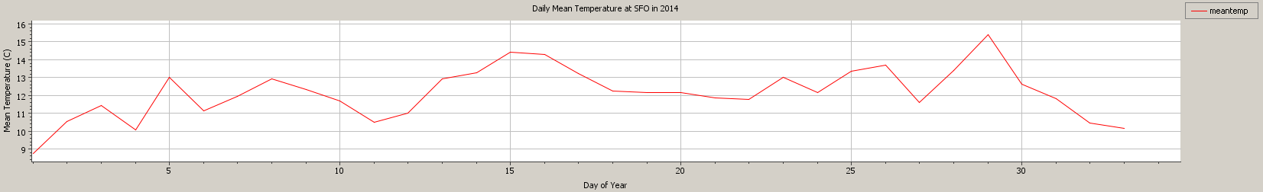
Alternate targets: Plots
SELECT USING INLINE avg(temperature) AS meanTemp, dt.dayofYear(dateUTC) AS dayIndex FROM scr1.wether
WHERE (year == 2014 AND station == "SFO")
INTO PLOT p2 h-axis:dayIndex v-axis:meanTemp plot-type:line h-label:"Day of Year" v-label:"Mean Temperature (C)" plot-label:"Daily Mean Temperature at SFO in 2014" ORDER BY dayIndex
Notes:
A complex pipe line
Select from a JOIN, filter and order then present the result as a plot

Slide 29
How to use it in R?
All The functions are accessible in R
Via the RQt package

Slide 30
The RQt Package
Install and load RQt
Needs rJava
Write your process
Either inline with the R scripts
Or in an external file

Slide 31
The RQt Package (cont.)
Execute the process
Can have multiple statements
Results are in variables
Results can be data frames or plots
Get the results
Use the results in R functions

Slide 32
Sample RQt scenario
Load the package
Get an engine instance
library(RQt)
library(ggplot2)
library(scales)
library(plyr)
engine <- rqt.getEngine()
ld <- rqt.loadProcess(engine, "D:\\Dropbox\\XQt\\Projects\\eval\\processes\\Paper.xqt")
Load scripts from external file
Watch the function result

Slide 33
Sample RQt scenario (cont.)
Run the process
Get detailed report
rn <- rqt.runProcess(engine)
err <- rqt.getRunReport(engine)
fsoData <- rqt.getVariable(engine, "fsoData")
ggplot(fsoData, aes(dayindex, meantemp)) + geom_line() +
xlab("") + ylab("Mean Temp deg C") +
ggtitle("2014 Average Daily Temperature at SFO")
Retrieve the result of a statement as a data frame
Use the result in R functions

Slide 34
Inline script sample
A connection is needed
cnnString <- "CONNECTION cnn1 ADAPTER=CSV SOURCE_URI='D:\\\\Projects\\\\PhD\\\\Data\\\\' PARAMETERS=delimiter:comma, fileExtension:csv, firstRowIsHeader:true"
bindingString <- "BIND b1 CONNECTION=cnn1 SCOPE=xdata_10, mydata1"
st1String <- "SELECT FROM b1.0 INTO var3"
st2String <- "SELECT USING INLINE avg(temperature) AS meanT, soilni as soilCategory FROM b1.0 INTO var4 ORDER BY meanT"
A binding is needed
A simple statement
A statement with aggregates

Slide 35
Inline script sample (cont.)
Get an engine instance
engine2 <- rqt.getEngine()
rqt.addScript(engine2, cnnString)
rqt.addScript(engine2, bindingString)
rqt.addScript(engine2, st1String)
rqt.addScript(engine2, st2String)
rn2 <- rqt.runProcess(engine2)
Load inline scripts
Run the process

Slide 36
Inline script sample (cont.)
var3 <- rqt.getVariable(engine2, "var3")
var4 <- rqt.getVariable(engine2, "var4")
Get result set “var3”
Get result set “var4”

Slide 37
Accessibility
XQt: https://github.com/javadch/XQt
Workbench: https://github.com/javadch/SciQuest
RQt: https://github.com/javadch/RQt
Executable: http://fusion.cs.uni-jena.de/javad/XQt/Workbench.zip
Email: javad.chamanara@uni-jena.de
License: GPL 3.x

